Slide 1
BST 260
Introduction to
Data Science
Fall 2019

Slide 2
Today
What is data science?
Why learn data science?
How do we learn data science?
Who is helping you learn data science?
Introduction to R, RStudio and RMarkdown

Slide 3
What is data science?

Slide 4
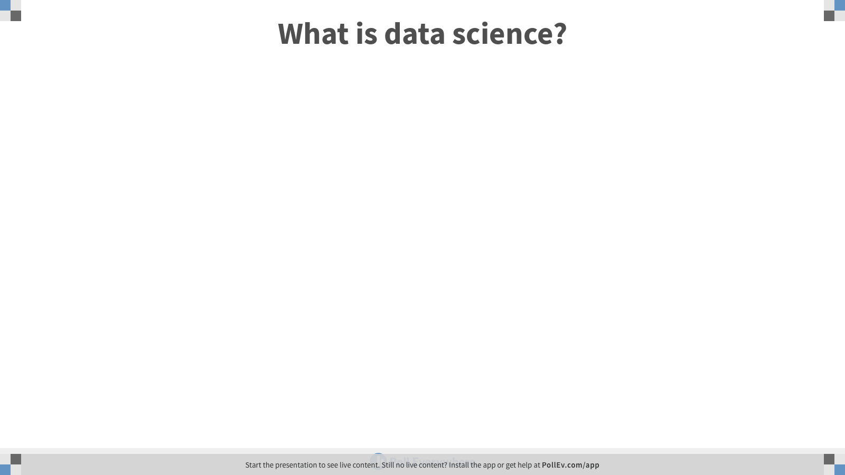

Slide 5
Data science is a multidisciplinary field that uses scientific methods, processes, algorithms and systems to extract knowledge and insights from structured and unstructured data

Slide 6
Data science is the field of study that combines domain expertise, programming skills, and knowledge of math and statistics to extract meaningful insights from data
Data Robot

Slide 7
The goal is to turn data into information and information into insight
Carly Florina, former CEO of Hewlett-Packard

Slide 8
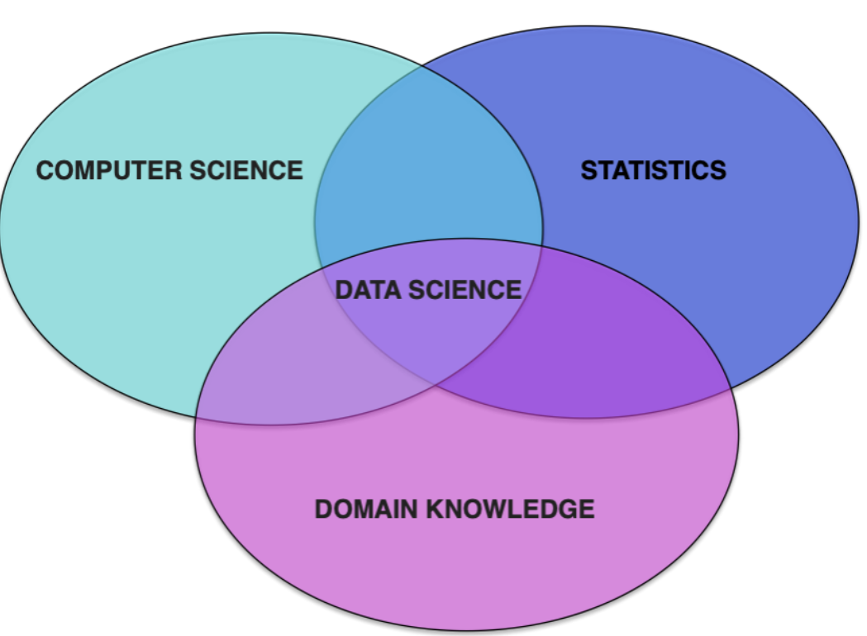

Slide 9
Why learn data science?

Slide 10
Hiding within those mounds of data is knowledge that could change the life of a patient, or change the world.
-Atul Butte,
Stanford University

Slide 11
You can have all the quantitative data you can get, but you still have to distrust it and use your own intelligence and judgement
Alvin Toffler, American writer and futurist

Slide 12
The ability to take data – to be able to understand it, to process it, to extract value from it, to visualize it, to communicate it is going to be a hugely important skill in the next decades, not only at the professional level, but even at the educational level for elementary school kids, for high school kids, for college kids. Because now we really do have essentially free and ubiquitous data.
Hal Varian, Economist at Google

Slide 13
Data Science Success Stories

Slide 14

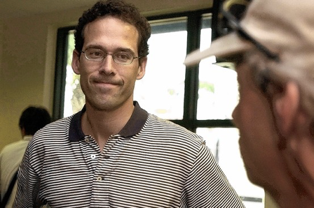
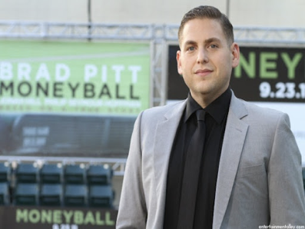
Actual data scientist
Hollywood

Slide 15
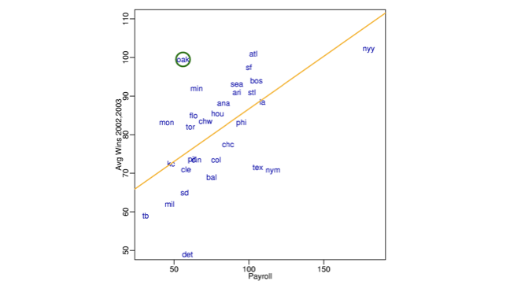
Moneyball
Starting around 2001, the Oakland A’s picked players that scouts thought were no good, but data said otherwise

Slide 16
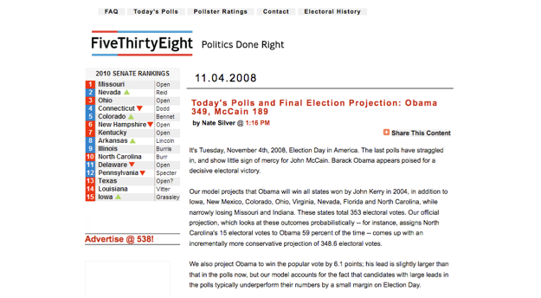
Elections
“Nate Silver won the election”
Predicted: 349 to 189, 6.1% difference
Actual: 365 to 173, 7.2% difference

Slide 17
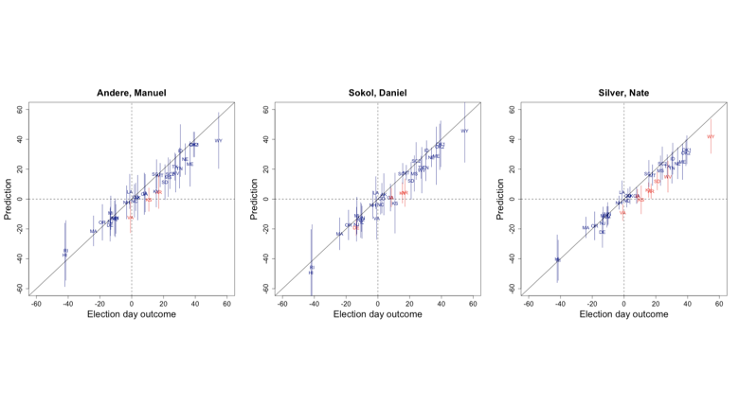
2014 Senate Race

Slide 18
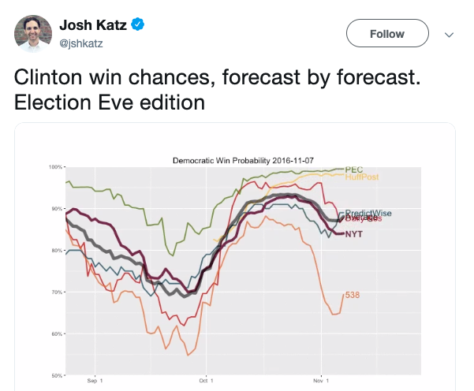
2016 Presidential Election
Twitter gif

Slide 19
Many other examples
Spell checkers
Speech recognition
Language translators
Digitizing books
Medical diagnostics
Personalized medicine
Etc.

Slide 20
Who is helping you learn data science?

Slide 21

Instructor
Heather Mattie
Instructor of data science
PhD Biostatistics, Harvard GSAS
Advisor: JP Onnela
Research centers on statistical network science, machine learning, algorithmic bias, health disparities
Email: hemattie@hsph.harvard.edu
Office: Building 1, 4th floor, room 421A
Phone: (617) 432-5308
Office Hour: Tuesdays 1-2pm

Slide 22
TA Team
Andy Shi (andyshi@g.harvard.edu)
Greyson Liu (gang_liu@g.harvard.edu)
Eric Dunipace (edunipace@g.harvard.edu)
Jane Liang (jwliang@g.harvard.edu)
Rolando Acosta (roa310@g.harvard.edu)

Slide 23
TA Office Hours
Monday
2-3pm, Greyson, Heather’s office
Wednesday
1-2pm, Jane, Building 2, 4th floor room 428
3:30-4:30pm, Rolando, Building 2, 4th floor room 428
Thursday
1-2pm, Eric, Kresge LL6
Friday
1-2pm, Andy, Building 2, 4th floor room 428

Slide 24
Labs
We will have labs centered around examples related to data and code presented in class. Labs will start next week and will be held almost every week - check canvas and the course website for the schedule
Wednesday
2-3:30pm, Rolando, Kresge LL6
Thursday
3:45-5:15pm, Greyson, FXB G11
Friday
11:30-1pm, Andy, Kresge G13

Slide 25
Course Details
Many modes of communication
Canvas site
GitHub site
Slack workspace

Slide 26
Grading
Homework
35% of final grade
5 homework assignments
Two midterms
30% of final grade; 15% each
Multiple choice questions on canvas
Some questions will require writing code
Final Project
35% of final grade
Can work alone or on a team of up to 4 people

Slide 27
Grading
You are welcome to discuss the course material and homework questions with others, but the work you turn in must be your own
You are not allowed to discuss during the midterms

Slide 28
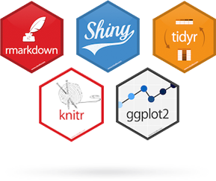


Homework
Real-world focus
Scrape and wrangle (clean) messy data
Explore data
Visualize data
Apply statistical analyses
Communicate results
Will be written in R and submitted via GitHub

Slide 29
Final Project
Individual or teams of up to 4 students
Choose your own data and project
Part 1: describe your project question and plan for answering it
Part 2: present results and conclusions
RMarkdown file
Screencast
Website

Slide 30
How do we learn data science?

Slide 31
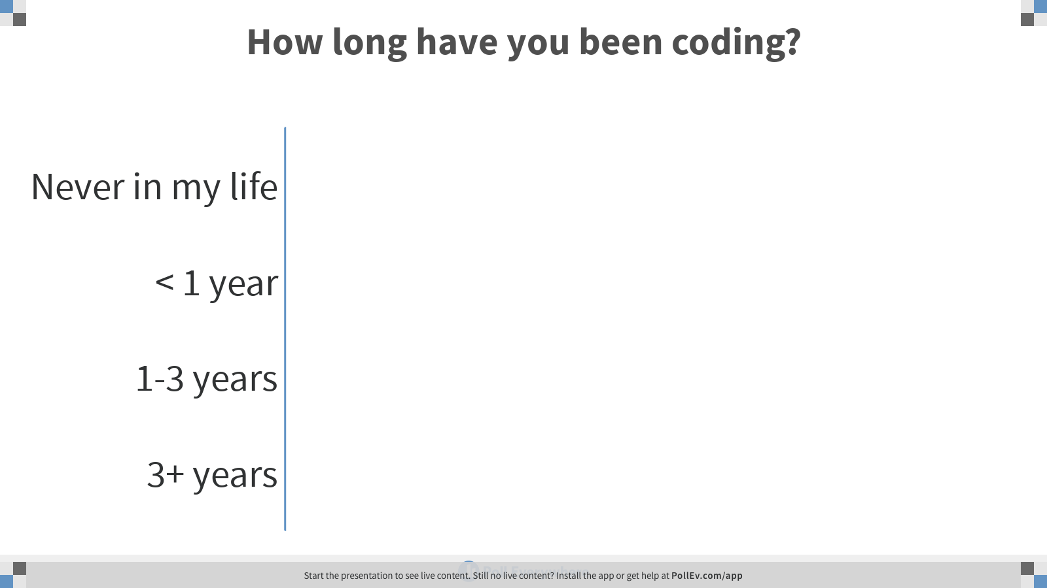

Slide 32
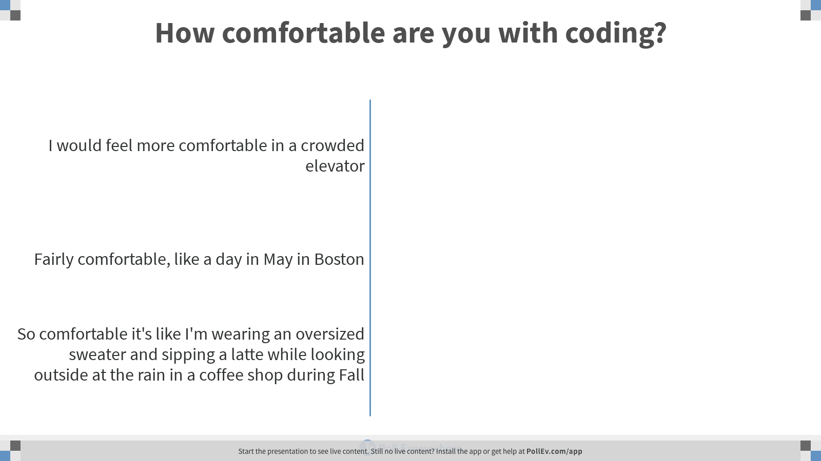

Slide 33
How will you learn? By doing it!
You will be coding - a lot
Skills you’ll learn
Computer programming
Data wrangling
Data visualization
Statistics
Machine learning
Communication of results and insights

Slide 34
Class will be centered around data
Homework and lectures will be based on diverse data sets
Bring your laptop to class!

Slide 35
What you need to do now
Download and install R and RStudio
Create a GitHub account
Complete this survey (also available on the course website and canvas)
Join the Slack workspace
Explore the course website
Make friends with your classmates - you’ll need them for the final project 😄

